Slide 1

Transistor Lifetime Optimization in Compliance with Safety and Reliability Standards
Rubayet Kamal
Hochschule Hamm-Lippstadt

Slide 2


ABOUT ME
Rubayet Kamal
Electronic Engineering

Slide 3
AGENDA
Introduction
History and Relevance
Reliability Standards and Fault Models
Role of Weibull cumulative distribution
Conclusion

Slide 4
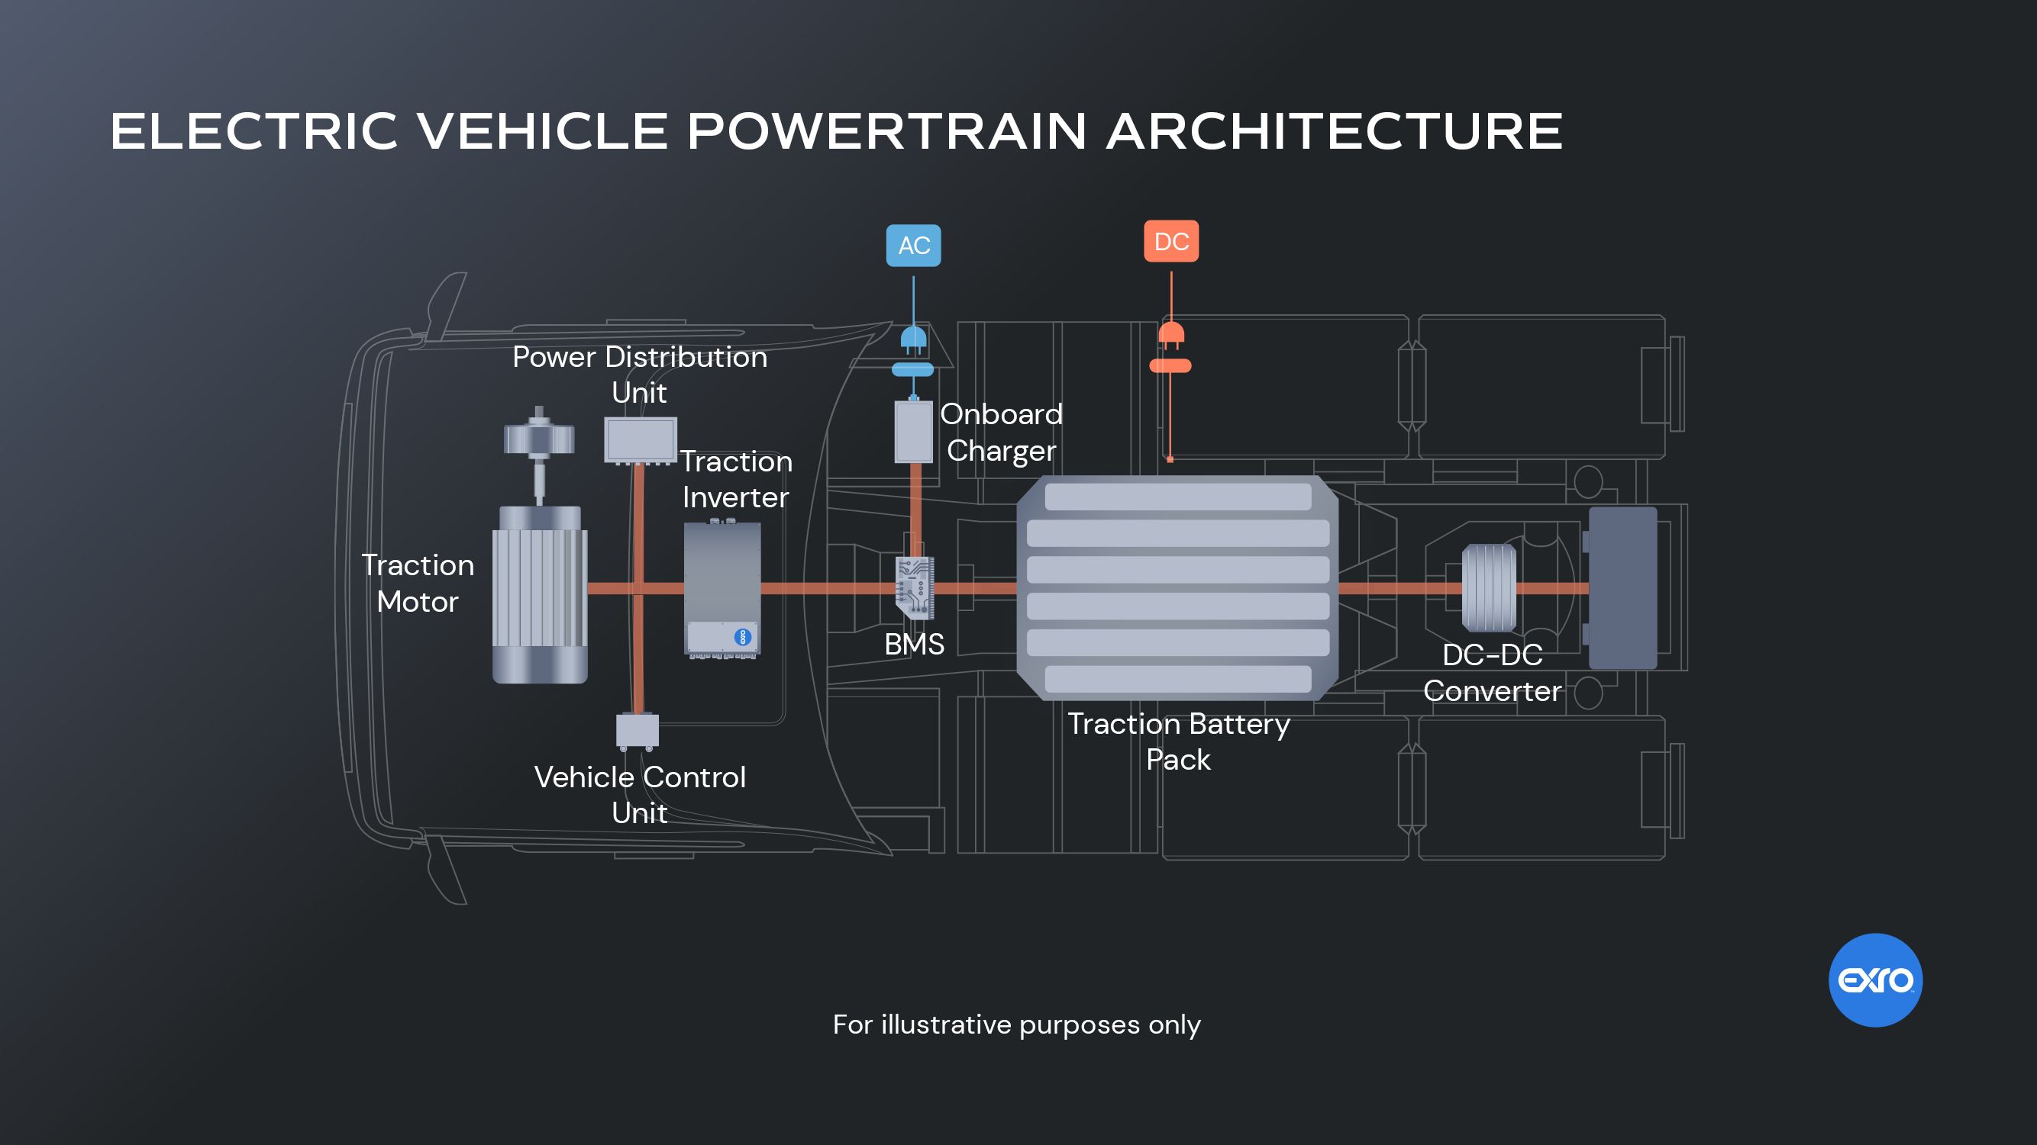

Slide 5
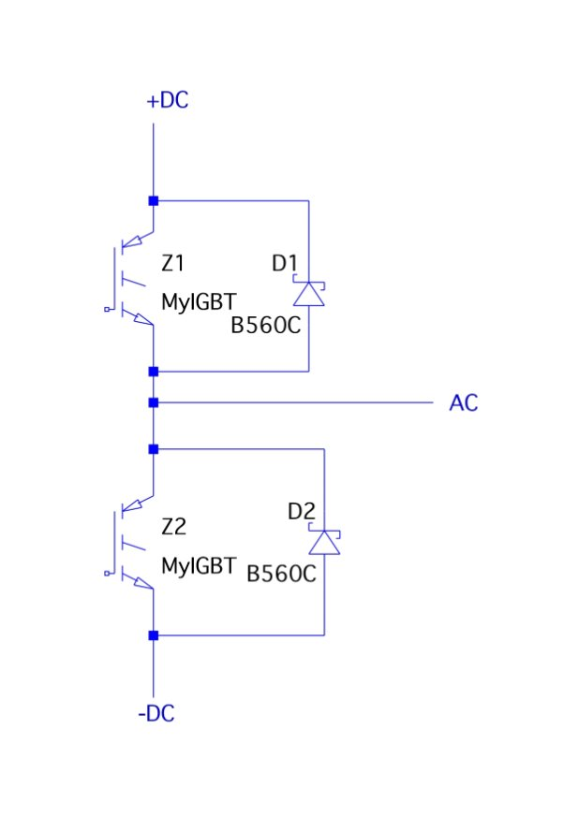
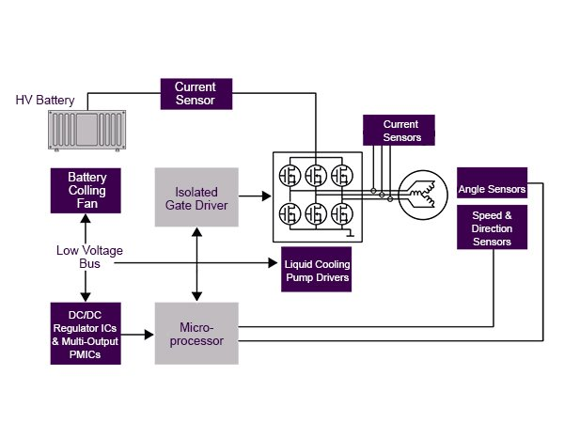
APPLICATION

Slide 6
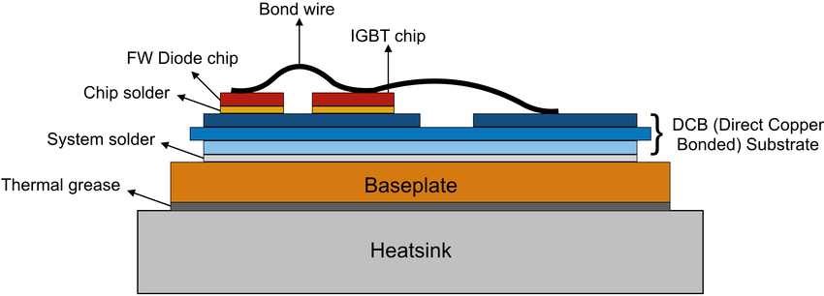
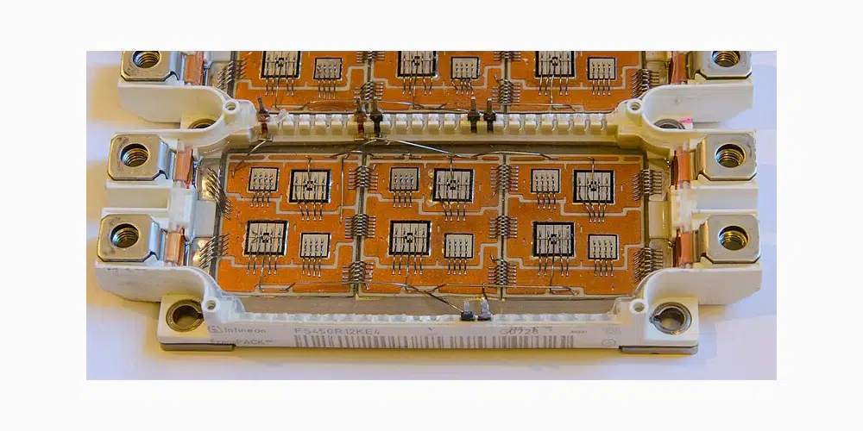
TYPICAL POWER MODULE

Slide 7
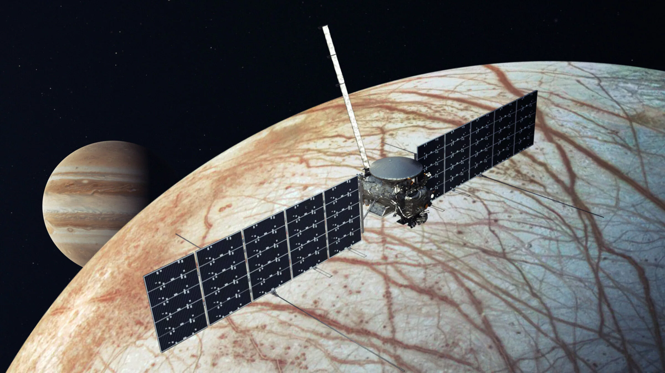
RECENT EVENT
"similar parts were failing at lower radiation doses than expected," NASA officials wrote in an update on Thursday (July 11, 2024).

Slide 8
WHY ARE THEY RELEVANT?

Slide 9
WHY ARE THEY RELEVANT?
Expected vehicle lifetime: 15 years.
Harsh operating conditions: Humidity, Temperature, Vibration.
Failures can lead to unsafe behavior or costly recalls.
Importance of Functional Safety and System Reliability.

Slide 10
FUNCTIONAL SAFETY
ISO 26262: for safety related systems that include electrical/electronic systems and that are installed in road vehicles.
ISO 26262‐11 – Guidelines on Application of ISO 26262 to Semiconductors.
Defines how components are robust but does not define how to prove reliability.
Topics:
Recommends providing evidence of robustness of semiconductor elements.
Semiconductor development lifecycle.
Safety analysis methods, mechanisms and diagnostic coverage.
Qualification and validation.

Slide 11
WHAT CAN GO WRONG?

Slide 12
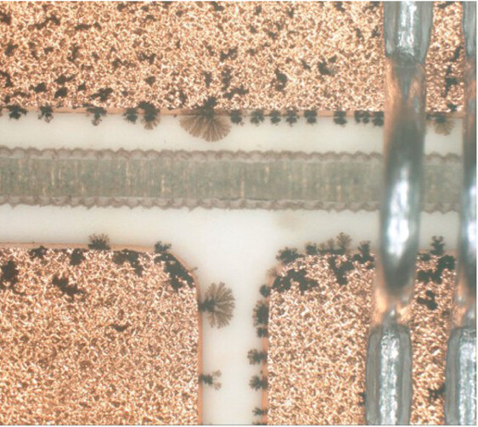
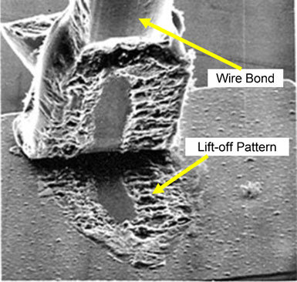
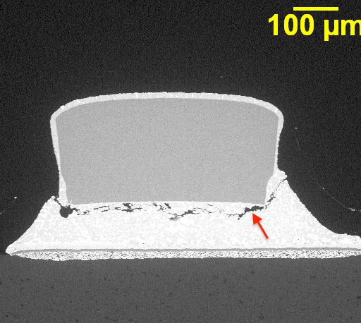
FAULT MODELS FROM POWER MODULES
Fig: Dendrite growth
Fig: Bond-wire lift off
Fig: Solder fatigue

Slide 13
HOW CAN WE MEASURE/ESTIMATE RELIABILITY?

Slide 14
LIFETIME ESTIMATION
Estimating Lifetime
Calculation
Testing
Field Experience

Slide 15
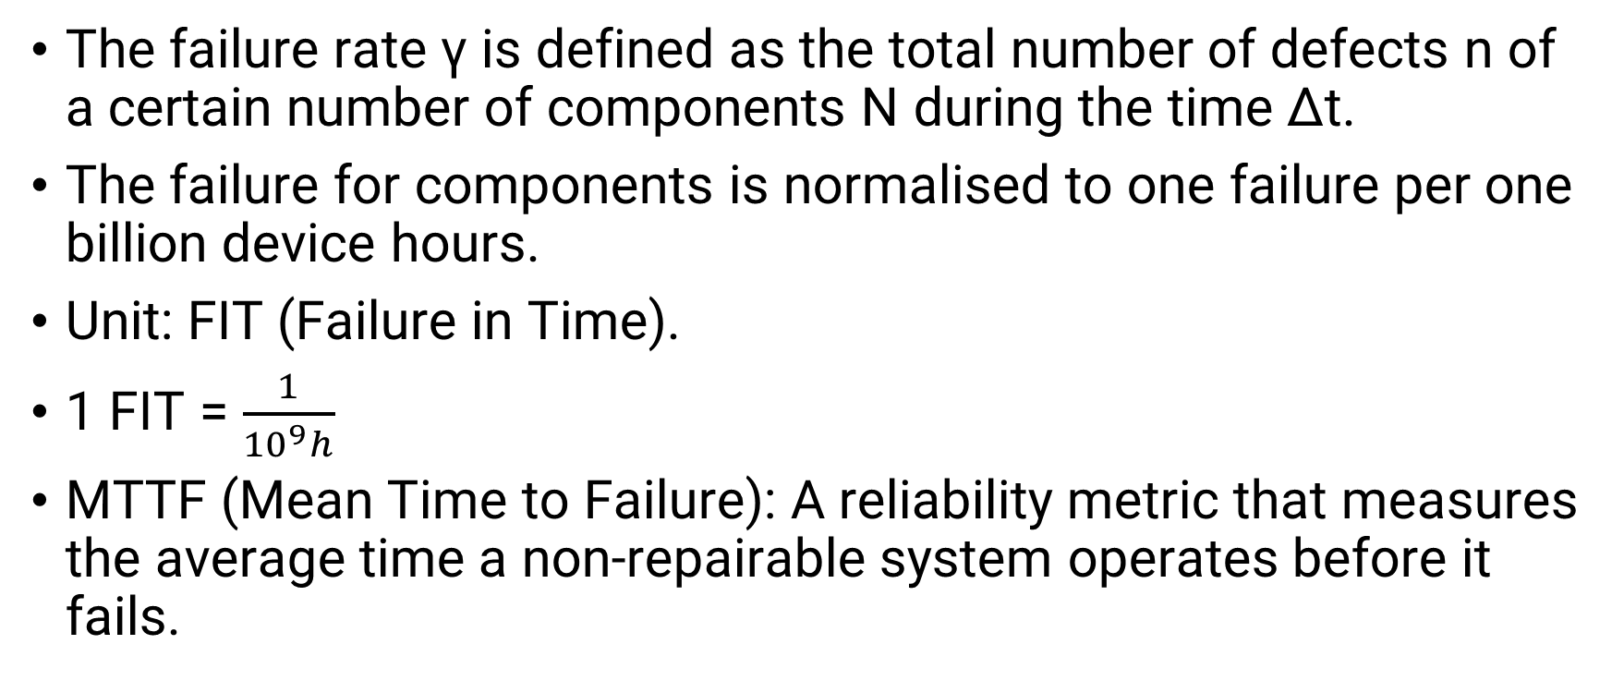
HOW TO MEASURE RELIABILITY?
The failure rate γ is defined as the total number of defects n of a certain number of components N during the time ∆t.
The failure for components is normalised to one failure per one billion device hours.
Unit: FIT (Failure in Time).
1 FIT = $\frac{1}{{10}^{9}h}$
MTTF (Mean Time to Failure): A reliability metric that measures the average time a non-repairable system operates before it fails.

Slide 16
HOW TO TEST RELIABILITY?
To ensure reliability of components, manufacturers must carry out test and qualification measures.
Would take as long as the lifetime of the application itself.
Not practical!
Accelerated tests: Higher stress but less testing time.

Slide 17
RELIABILITY STANDARDS
SN 29500: analytical model to predict reliability tailored for industrial and automotive conditions.
MIL-STD-750D: uniform methods for testing semiconductor devices for military domain.
AQG 324: industry guideline for automotive supply chain of power electronic converter units.

Slide 18
SUMMARISING THE STANDARDS
Standard | Domain | Purpose | Output
ISO 26262-11 | Functional Safety | Required reliablility evidence | Safety compliance
SN 29500 | Analytical | Predicts failure rate | FIT, MTBF
MIL-STD-750D | Experimental | Defines stress test procedures | Physical test results
AQG 324 | Automotive | Qualifies power modules | Lifetime & degradation data

Slide 19
SN 29500
Siemens table provide base failure rates and temperature correction factors.
Statistical formulas and component data to predict failure rates.
Look-up table to find reference FIT rate and temperature for various component types.
Application FIT rate = reference FIT rate and temperature × temperature factors × voltage factors × current factors × % time stress factors.

Slide 20
MIL-STD-750D
US military standard defining reliability and qualification tests for semiconductors.
Focuses on physical reliability validation through stress testing.
Provides accelerated test procedures to reveal degradation mechanisms.
Does not directly define how to improve lifetime.
Guides design improvement efforts.

Slide 21
AQG324
Developed by ECPE e.V., Europe.
Covers complete power modules, not single chips.
Divided into two main categories: Environmental and lifetime.
Each test has defined stress levels, number of cycles and sample size.
Identifies degradation mechanisms to guide design improvements.
Results of AQG 324 tests are used for calibrating lifetime models.

Slide 22
TEST CONDITIONS
Test | Conditions
Power Cycling | Number of cycles = 130000 Period of each cycle = 2s to 5s Change in junction temperature = 60K
High Temperature Reverse Bias Test | 1000h
Thermal Shock Test | Min temp = -40°C, Max temp = 125°C, 20-50 cycles

Slide 23
FAULT MODELS AND RELATED TESTS
Failure mechanism | Related test
Bond-wire lift-off | Power Cycling
Solder fatigue
Bond connection | Vibration Tests
Electrical connection
Spatial defect in the semiconductor | High Temperature Reverse Bias Test (HTRB)
Surface defect of the semiconductor

Slide 24
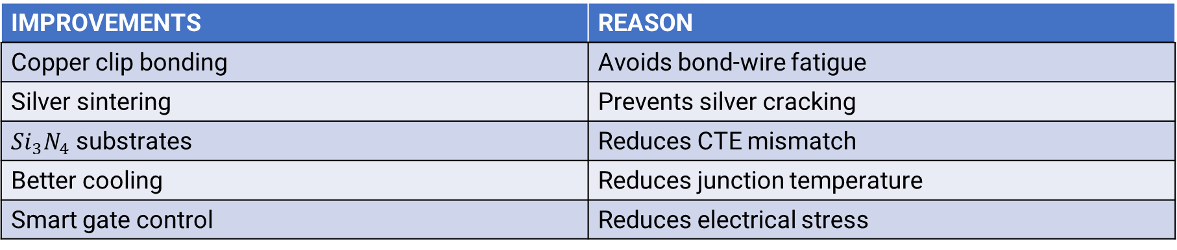
FROM TESTING TO IMPROVEMENT
IMPROVEMENTS | REASON
Copper clip bonding | Avoids bond-wire fatigue
Silver sintering | Prevents silver cracking
${Si}_{3}N_{4}$ substrates | Reduces CTE mismatch
Better cooling | Reduces junction temperature
Smart gate control | Reduces electrical stress

Slide 25
WEIBULL ANALYSIS AND FIELD CORRELATION
Statistical method to model time-to-failure data.
Allows engineers to extract lifetime characteristics.
To understand whether failures occur due to earily defects, randoms events or wear-out mechanisms.
Results from tests in AQG 324 and MIL-STD-750D are analysed.
Weibull distribution to determine the characteristics lifetime and failure behaviour of devices.

Slide 26
WEIBULL ANALYSIS PROESS
Collect Life
Choose Appropriate Weibull Model
Estimate Weibull Parameters
Calculate Reliablity Metrics
Perform of Goodness of Fit Tests
Plot the data on a Weibull Plot

Slide 27
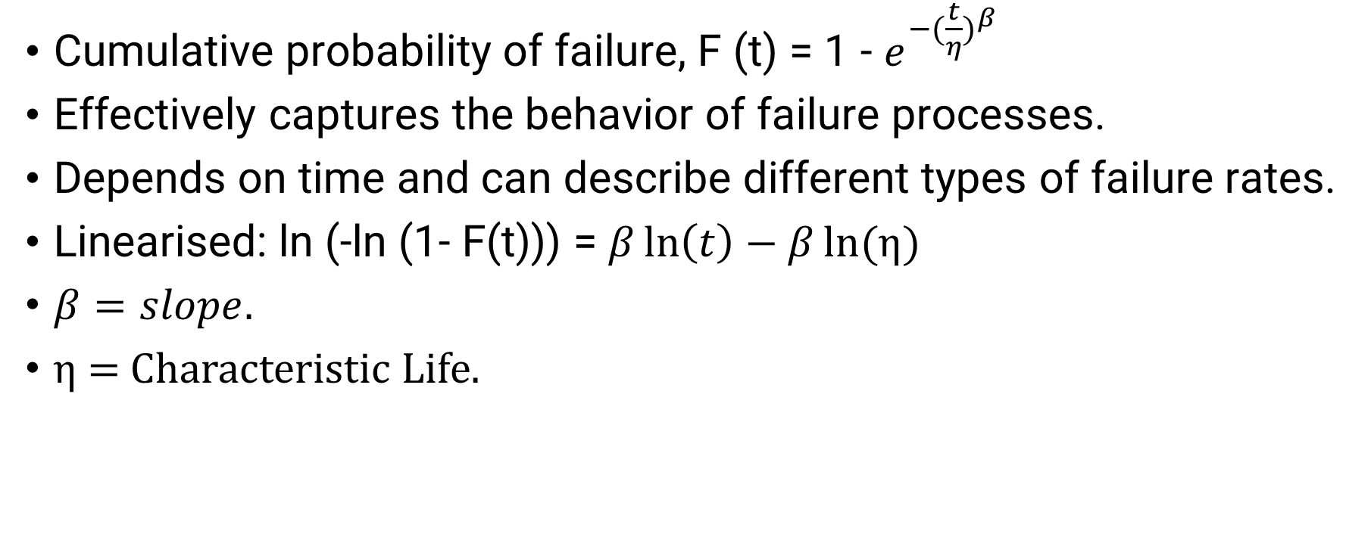
METHODOLOY FOR WEIBULL
Cumulative probability of failure, F (t) = 1 - $e^{{−(\frac{t}{η})}^{β}}$
Effectively captures the behavior of failure processes.
Depends on time and can describe different types of failure rates.
Linearised: ln (-ln (1- F(t))) = $β\ln\left(t\right)−β\ln{(}$η)
$β=slope.$
η = Characteristic Life.

Slide 28
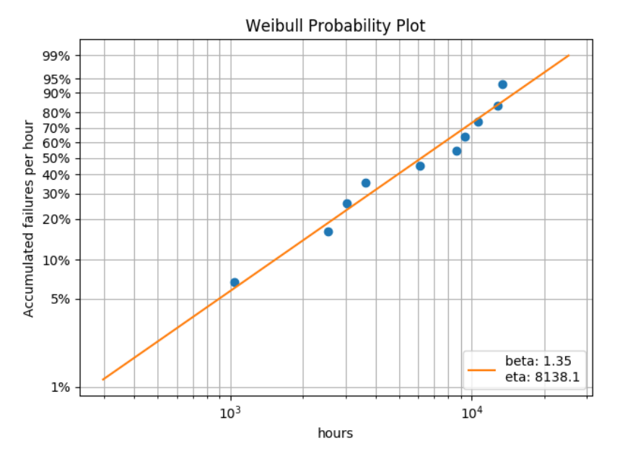

Slide 29
TO SUM UP
ISO 26262-11 defines safety requirements.
SN 29500 predicts lifetime.
MIL-STD-750D and AQG tests lifetime.
Insights used to design improvements that extend transistor lifetime.

Slide 30
TAKEWAYS.
Tests do not improve lifetime.
They reveal what needs to be improved.
Calculated values are too conservative.
Field data is not always available.
Accelerated tests might use overestimated conditions.
All test output can be used and combined with Webull to provide better reliable and lifetime data.

Slide 31
CONTACT
Rubayet Kamal
+49 176 40063941 rubayet.kamal@stud.hshl.de

Slide 33
References
[Slide 4] https://www.exro.com/industry-insights/ev-power-electronics-explained
[Slide 5] https://www.everythingpe.com/community/what-is-a-traction-inverter
[Slide 6] https://www.researchgate.net/figure/Cross-sectional-view-of-wire-bonded-IGBT-power-modules_fig1_363848105
Slide [6] https://www.pcba-manufacturers.com/igbt-module/
[Slide 7] https://www.planetary.org/space-images/europa-clipper-artists- concept?_gl=1*t9iguz*_up*MQ..*_ga*MTQ2ODQ5NDE4NS4xNzYyNDM1NTU2*_ga_HV4XDQL72V*czE3NjI0MzU1NTQk bzEkZzAkdDE3NjI0MzU1NTQkajYwJGwwJGgw
[Slide 10] https://www.iso.org/publication/PUB200262.html
[Slide 12] https://ietresearch.onlinelibrary.wiley.com/doi/10.1049/pel2.70015?af=R
[Slide 12] https://www.researchgate.net/figure/Scanning-electron-microscopy-SEM-image-of-wire-bond-liftoff-pattern- 1_fig14_257804210
[Slide 12] https://www.semlab.com/solder-joint-fatigue/solder-fatigue-2/
[Slide 15] IGBT Modules, Infineon Technologies AG, Andreas Volke, Michael Hornkamp.
[Slide 16] IGBT Modules, Infineon Technologies AG, Andreas Volke, Michael Hornkamp.
[Slide 19] https://www.ti.com/lit/wp/sloa294a/sloa294a.pdf?ts=1762463988273&ref_url=https%253A%252F%252Fwww.bing.co m%252F
[Slide 20] https://www.navsea.navy.mil/Portals/103/Documents/NSWC_Crane/SD-18/Test%20Methods/MILSTD750.pdf
[Slide 21] https://www.ecpe.org/research/working-groups/automotive-aqg-324/
[Slide 26] https://s3-us-west-1.amazonaws.com/accendo-media/wp-media-folder-accendo-reliability/wp- content/uploads/2024/12/WeibullAnalysisGuidelineandCaseStudy-PardusConsulting.pdf

Slide 34
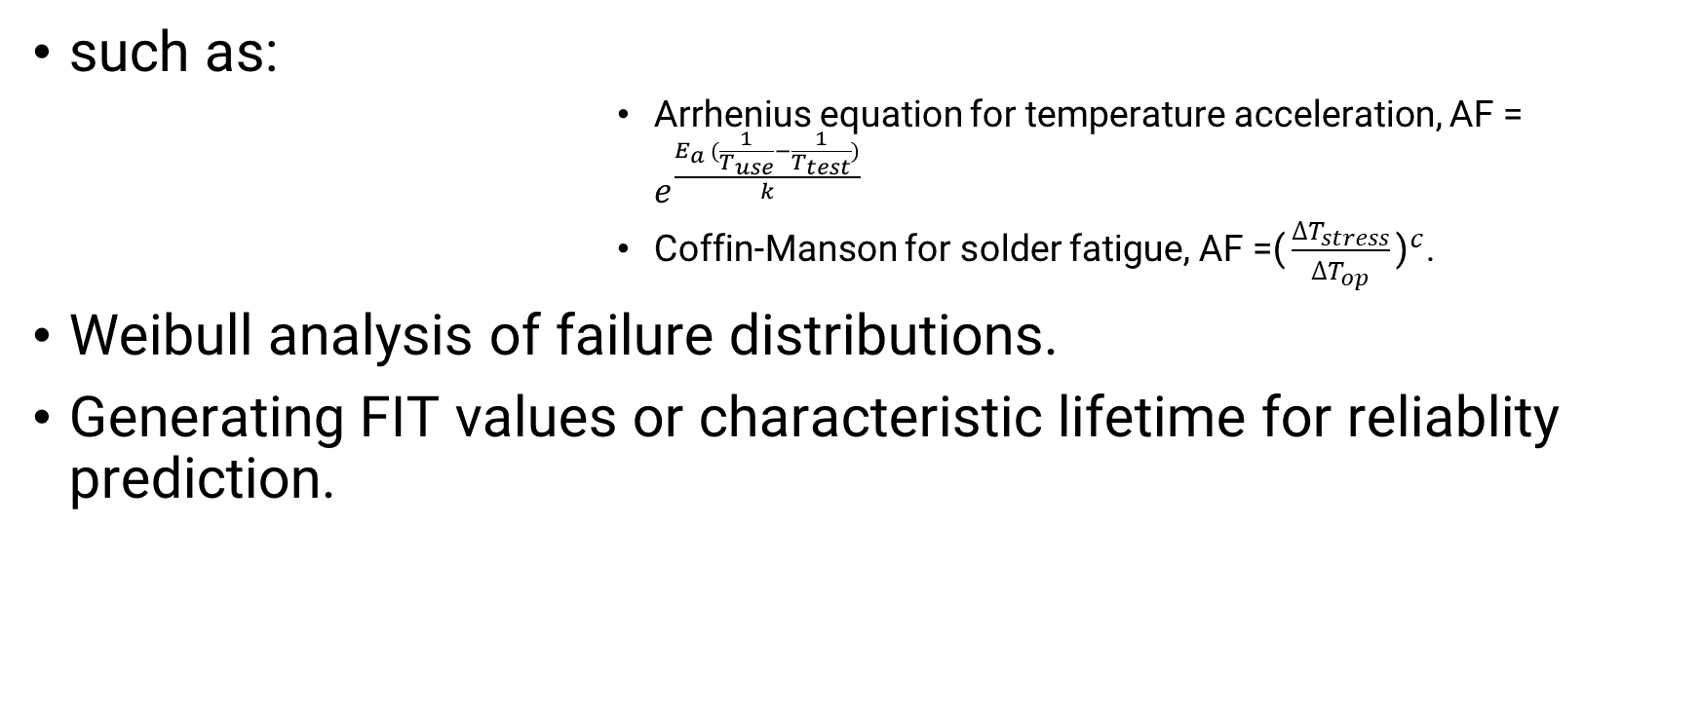
AQG324
such as:
Arrhenius equation for temperature acceleration, AF = $e^{\frac{E_{a }(\frac{1}{T_{use}}−\frac{1}{T_{test}})}{k}}$
Coffin-Manson for solder fatigue, AF =${\text{(}\frac{∆T_{stress}}{∆T_{op}}\text{)}}^{c}$.
Weibull analysis of failure distributions.
Generating FIT values or characteristic lifetime for reliablity prediction.

Slide 35
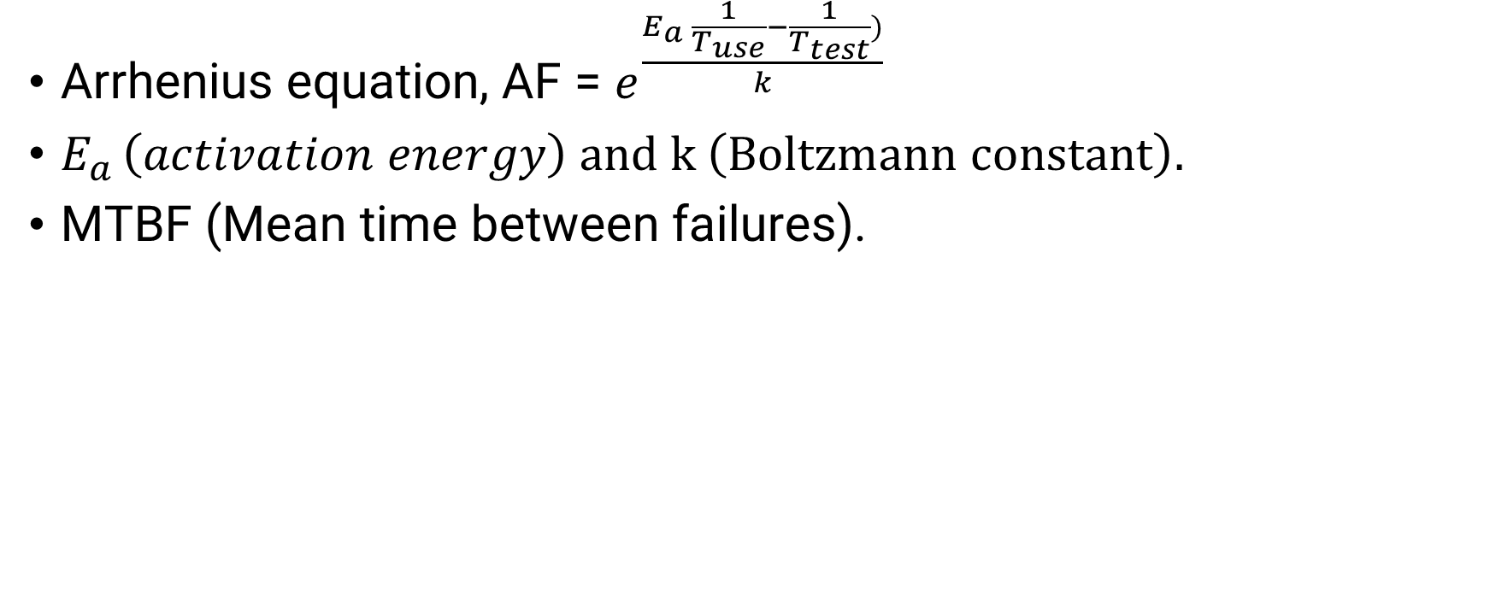
SN 29500
Arrhenius equation, AF = $e^{\frac{E_{a }\frac{1}{T_{use}}−\frac{1}{T_{test}})}{k}}$
$E_{a }\left(activation energy\right) and k \left(Boltzmann constant\right).$
MTBF (Mean time between failures).

